Slide 1

PROFESSIONAL ETHICS
TOPIC:-
GENDER DISCRIMINATION SEXUAL HARASSMENT AND ENVIRONMENTAL ETHICS
GROUP MEMBERS:-
MUHAMMAD ASHIR IQBAL(ROLL NO :-AI-039)
ABDUL AAKHIR SAIF ULLAH(ROLL NO :- AI-041)
SAEED AHMED(ROLL NO :- AI-038)

Slide 2

Content
01
Gender Discrimination
Introduction
Metaphors about Gender Discrimination
Ethical Framework for Gender Discrimination
Religious Perspective on Gender Discrimination
Conclusion
Sexual Harassment
Introduction
Metaphors about Sexual Harassment
Ethical Framework for Sexual Harassment
Religious Perspectives on Sexual Harassment
Conclusion
1.1
1.2
1.3
1.4
1.5
02
2.1
2.2
2.3
2.4
2.5

Slide 3
Content
03
Environmental Ethics
Introduction
Metaphors about Environmental Ethics
Ethical Frameworks for Environmental Ethics
Religious Perspectives on Environmental Ethics
Conclusion
3.1
3.2
3.3
3.4
3.5

Slide 4
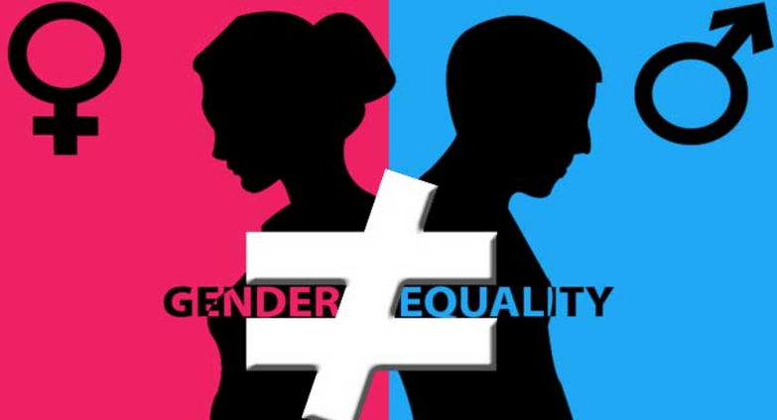
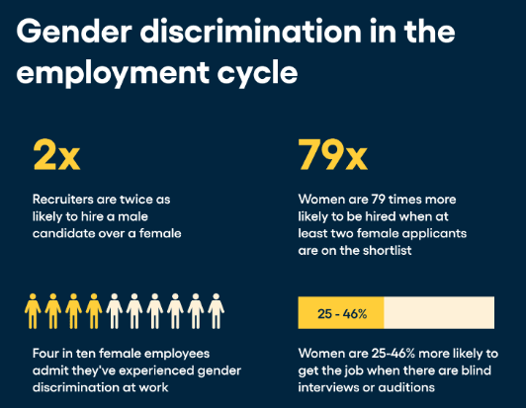
1.Gender Discrimination
1.1. INTRODUCTION:-
Gender discrimination refers to the unfair treatment of individuals based on their gender, often resulting in limited opportunities, unequal pay, and restricted access to leadership roles. It is rooted in societal stereotypes and ingrained biases that favor one gender, typically men, over others, primarily women and gender minorities.

Slide 5
1.2 Two Metaphors about Gender Discrimination:-
1.2.1. The Glass Ceiling:-
This metaphor represents an invisible barrier that prevents women and minorities from advancing to leadership roles, despite having the qualifications and experience necessary for those positions. It suggests that while women can see the higher positions, societal and organizational structures keep them from reaching those roles, resulting in unequal representation in corporate and political leadership.

Slide 6
1.2.2 The Double Bind:-
The double bind describes a situation in which women face conflicting expectations in the workplace. If they conform to traditional feminine roles—being nurturing and cooperative—they are viewed as weak and unsuitable for leadership. However, if they act assertively or decisively, qualities typically associated with leadership, they are criticized for being too aggressive or unfeminine. This contradiction places women in a no-win situation, making it difficult for them to succeed without facing criticism.

Slide 7
1.3 Ethical Frameworks for Gender Discrimination
Human-centered ethics focuses on the impact of gender discrimination on human well-being, arguing that everyone deserves equal treatment and opportunities, regardless of gender.
1.3.1 Utilitarianism:-
It aims to maximize benefits for society by promoting gender equality, ensuring that talent is not wasted due to discriminatory practices. Organizations benefit from diverse perspectives, leading to greater innovation and productivity.

Slide 8
1.3.2 Rights Ethics:-
Emphasizes the right of individuals to be treated equally and fairly, without discrimination based on gender. Everyone has a right to equal opportunities in education, employment, and leadership.
1.3.3 Duty Ethics:-
It focuses on the moral duties of individuals and organizations to eliminate gender discrimination and ensure that workplaces are inclusive and fair. This involves creating policies that promote equal pay, access to promotions, and preventing biased practices.

Slide 9
1.4 Religious Perspectives on Gender Discrimination
1.4.1 Judeo-Christian Ethics:-
These traditions emphasize that all human beings are created equal in the image of God, advocating for the dignity and worth of both men and women.
1.4.2 Islam:-
Islam emphasizes equality and fairness between genders, asserting that men and women have complementary roles but deserve equal rights and opportunities.

Slide 10
1.4.3 Asian Religions :-
Emphasize balance and unity, advocating for mutual respect between genders. In these traditions, harmony in society is achieved through recognizing the value of all individuals, regardless of gender.
1.4.4 Native American Beliefs:
In many Native American cultures, women hold significant social, political, and spiritual roles, with traditions emphasizing respect and balance between the genders.

Slide 11
1.5 Conclusion:-
Addressing gender discrimination requires systemic changes within organizations, educational systems, and societies at large. By applying ethical principles and recognizing the inherent worth of all individuals, progress can be made toward a world where opportunities are not restricted by gender. Dialogue, education, and legal reforms are essential in creating an equitable environment for all.

Slide 12
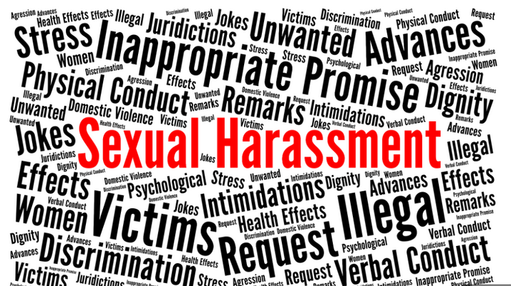

2. Sexual Harassment
2.1 INTRODUCTION:-
Sexual harassment refers to unwelcome sexual advances, requests for sexual favors, and other verbal or physical conduct of a sexual nature that creates an intimidating, hostile, or offensive work or educational environment. It violates a person's dignity and contributes to a culture of fear and inequality.

Slide 13
2.2 Two Metaphors about Sexual Harassment
2.2.1 The Iceberg Metaphor:-
Sexual harassment is often compared to an iceberg, where only a small portion is visible above the surface, while the majority remains hidden. This metaphor suggests that while some cases of sexual harassment come to light, the vast majority are never reported due to fear of retaliation, shame, or societal pressures.

Slide 14
2.2.2 The Poisoned Well:-
This metaphor describes how sexual harassment, like poison in a well, contaminates the environment for everyone. A workplace or community where harassment is tolerated becomes toxic, affecting the morale, productivity, and mental health of all members, not just the direct victims.
2.3Ethical Frameworks for Sexual Harassment
Sexual harassment violates the dignity and safety of individuals, undermining their ability to work and live in a secure environment.

Slide 15
2.3.1 Utilitarianism:-
Sexual harassment harms not only the victims but also the broader community by creating a hostile environment, reducing productivity, and fostering inequality. A utilitarian approach demands the elimination of harassment to promote the greatest good for the greatest number.
2.3.2 Rights Ethics:-
Every individual has the right to work, learn, and live in an environment free from harassment. Sexual harassment infringes on these rights, making it morally unacceptable.

Slide 16
2.3.3. Duty Ethics:-
Individuals, organizations, and society have a moral duty to prevent and address sexual harassment. This includes implementing strict policies, ensuring accountability, and protecting victims from retaliation.
2.3.4. Virtue Ethics:
Sexual harassment violates the virtues of respect and encourages fostering virtues like respect, empathy, and integrity within organizations. Leaders should embody these values and set a tone of zero tolerance for harassment, promoting a culture where all employees feel safe and respected. integrity, and empathy. Virtue ethics encourages creating environments where individuals

Slide 17
2.4. Religious Perspectives On Sexual Harassment
2.4.1. Judeo-Christian:-
In this tradition, sexual harassment is considered a violation of the dignity and respect that should be afforded to every person. It calls for accountability and justice for perpetrators and protection and healing for victims.
2.4.2. Islam:-
Strongly condemns any form of abuse or exploitation, including sexual harassment. Islamic teachings promote respect, modesty, and the safeguarding of individuals from harm, placing a strong emphasis on the protection of women.

Slide 18
2.4.3. Asian Religions :-
These religions advocate for treating all beings with respect and compassion. Acts of sexual harassment are seen as harmful disruptions to the moral balance, violating the principles of kindness and non-harm.
2.5. Conclusion :-
Sexual harassment undermines the safety and dignity of individuals in workplaces and other environments. To combat this issue, it is essential to create policies and foster cultures that support victims and hold offenders accountable. Ongoing education, dialogue, and legal action are crucial steps toward eradicating harassment and ensuring respect for all individuals.

Slide 19

3. Environmental Ethics:-
3.1. INTRODUCTION :-
The study of moral issues concerning the environment and moral perspectives on those issues.

Slide 20
3.2. Metaphors about the Environmental Ethics:-
3.2.1. The Invisible Hand:-
Optimistic metaphor from Adam Smith’s The Wealth of Nations. Self-interest in business benefits society, but unchecked growth leads to environmental issues like pollution and habitat destruction.
3.2.2. The Tragedy of the Commons:
Cautionary metaphor from Garrett Hardin. Common resources, like air and water, are overused when individuals act in self-interest without regulation.

Slide 21
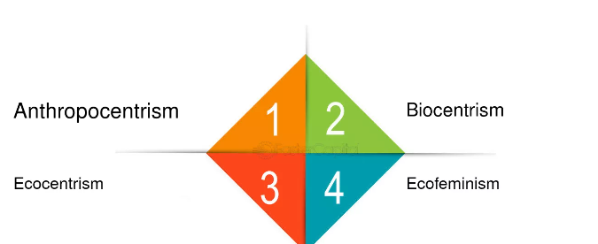
3.3 Moral Frameworks on Environmental Ethics :-
Anthropocentric:- Focuses on human benefits and threats from environmental degradation.
Sentient-Centered Ethics: Focuses on the inherent worth of sentient animals (those capable of feeling pain). Rejects "speciesism."
Biocentric Ethics: Considers all living organisms to have inherent worth. Paul Taylor's four duties are nonmaleficence, noninterference, fidelity, and restitution.
Ecocentric Ethics: Values ecosystems as a whole.
Advocates for preservation and ecological health.

Slide 22
3.4. Religious Perspectives on Environmental Ethics
3.4.1. Judeo-Christian:-
Dominion vs. stewardship over the earth.
3.4.2. Islam:-
Stewardship and responsible use of resources.
3.4.3. Asian Religions :-
Emphasize unity with nature, nonviolence, and harmony.

Slide 23
3.4.4. Native American Beliefs:-
Nonhuman creatures have spirits, to be treated with respect.
3.5. Conclusion
Engineers, corporations, and communities must work together to protect the environment, encouraging ongoing dialogue and respect for different perspectives.

Slide 24


THANK YOU

